Slide 1
ENSE 400 Bi-Weekly Scrum Report-Out
URStreamSight
Avery Cameron, Raymond Knorr, Noah Rowbotham
January 21, 2020
Notes:
R

Slide 2
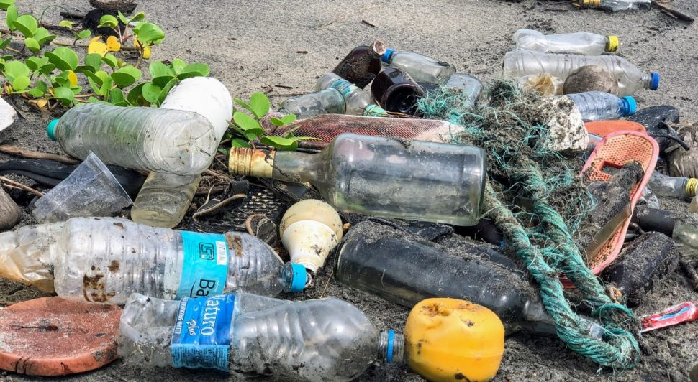
Project deats
Problem:
Citizens across Canada are confused regarding what proper recycling is.
Gap we are filling:
Giving data to municipalities to allow them to track/correct problem at its source (the people recycling). We are not actually sorting any recycling.
Innovation we are introducing:
Web application for municipality workers that scores recycling on a neighborhood basis and displays the data.

Slide 3
General Discussion: Mitacs and IP?
Notes:
Signed contract
gettin paid
monorepo (just mention here, talk about it later)

Slide 4
Project & Documentation review
What are you currently working on?
API Integration with NestJS, and Nx Monorepo
Implementing RBAC with NestJS
Finishing up training data pipeline
Future work
Seeding Data for API Database
Implementing testing plan for API
Operate bin detection model on collection vehicle
Training the contamination detection model
“Show me what you got” (including but not limited to…)
API and Monorepo
Bin detection model
Raw video to training samples
Aaeon board setup
GitHub/Version control “stamp of approval”
Is it readable, usable, “goodness” confirmed
Notes:
What are we currently working on:
API Integration with NestJS, and Nx Monorepo
Implementing RBAC with NestJS
Finishing up training data pipeline
Seeding Data for API Database
Implementing testing plan for API
Operate bin detection model on collection vehicle
Training the contamination detection model
“Show me what you got”:
Database Schema
API and Monorepo
Bin detection model
Raw video to training samples
Aaeon board setup
GitHub/Version control “stamp of approval” is good
Links for everything are on Github

Slide 5
Nx Monorepo | Nest API w/ RBAC and DB Integration
Notes:
Avery:
Nx Monorepo: Allows you to have multiple projects in one place and easier sharing of information while staying separate. Prairie robotics wanted to move to a monorepo to avoid npm library hosting for shared imports.
Nest API: We moved our API to the Nest framework to allow for our code to be more SOLID and DRY. We researched Nest, routing-controller, and express (which we were using before) and found that Nest enforced single responsibility and enhanced readability. The switch went well and provides more modular code. We then added Swagger documentation generation to visualize our endpoints.
Ray: Specifying routes, using sequelize, and how RBAC is done

Slide 6
Machine Learning | AWS | Aaeon Machine

Slide 7

Video to Sample Process

Slide 8
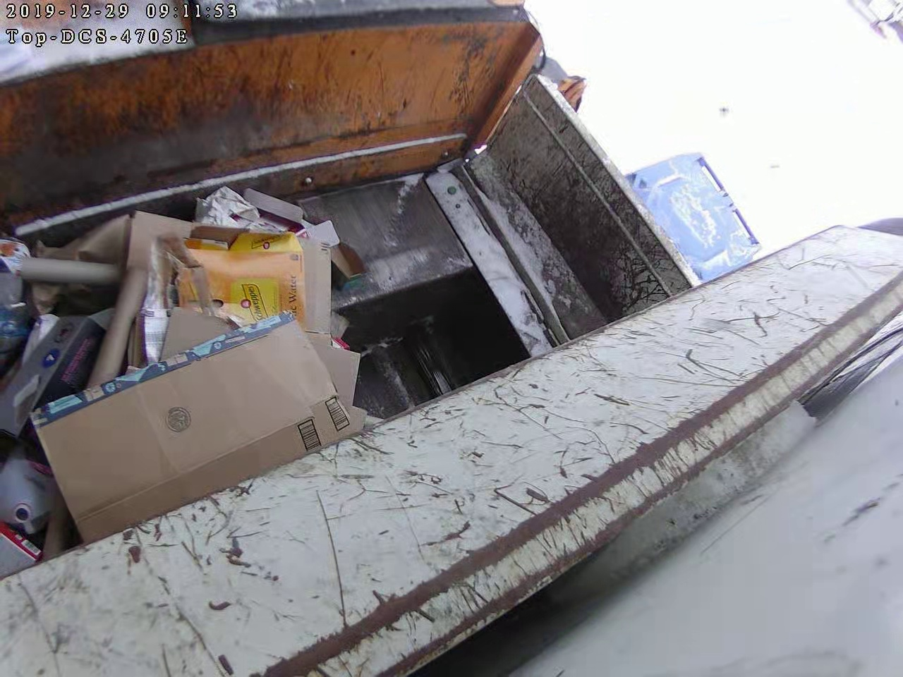
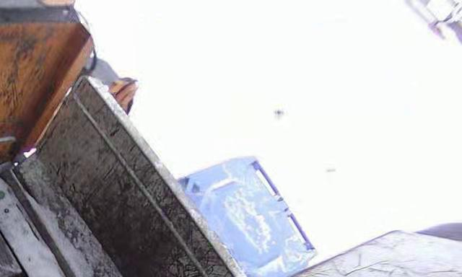
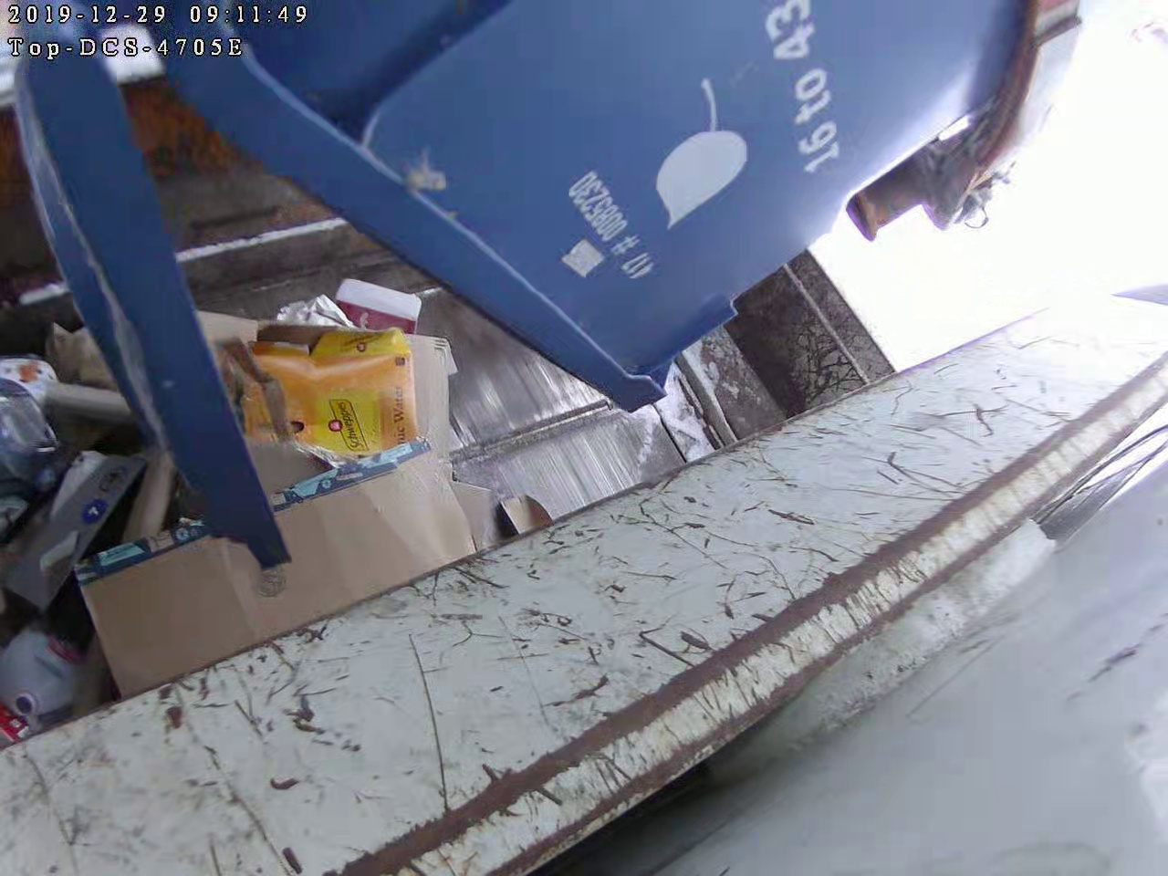
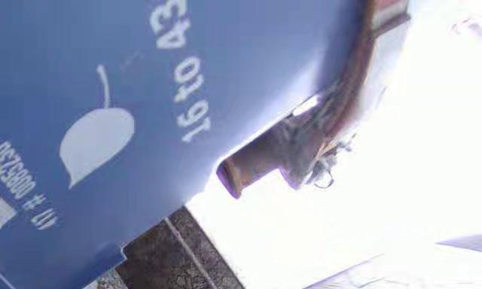
Video to Sample Process
Crop frame to corner
Detect if bin present

Slide 9
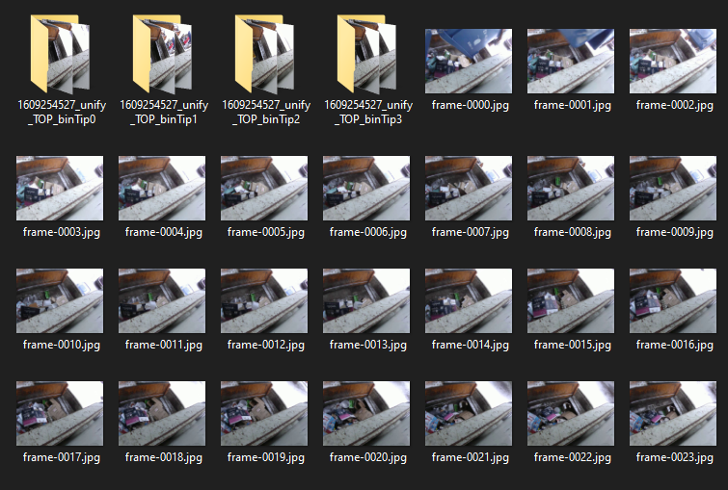
Video to Sample Process

Slide 10
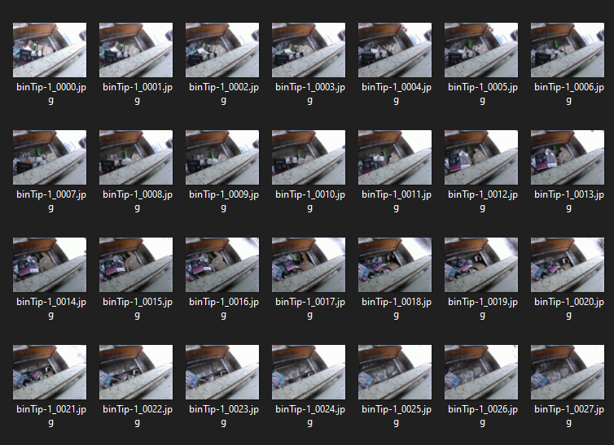
Video to Sample Process

Slide 11
Aaeon Board
New Goal
Bin detection model local to the collection vehicle hardware
When bin is detected, trigger cameras to take pictures of the waste once bin has lowered, 2 pictures a second taken once bin lowers
This eliminates a lot of unnecessary steps, ready to train samples are uploaded to AWS rather than videos that require processing

Slide 12
Group reflection
Do you feel you are on track?
We feel that we are on track. We did a lot of work on the API and included RBAC already which we are pleased with. Development of first working ML models is also promising.
Do you feel there are barriers to your success (if any)?
Nothing at the moment.
Do you need any help going forward?
Just more discussions with mentors about project scope and documentation
Any other questions or concerns?
What sort of testing plan should we follow. Front-end as well as API.
Notes:
R

Slide 13
Image Refs
https://cleanriver.com/how-to-reduce-recycling-contamination/

